Slide 1
Visualizing employee attendance trends with excel charts
STUDENT NAME: Sankari. P
REGISTER NO:312217052(asunm1659312217052)
DEPARTMENT:B com (general)
COLLEGE:Shri krishnaswamy college for women

Slide 2
PROJECT TITLE
Visualizing employee attendance trends with excel charts

Slide 3


AGENDA
Problem Statement
Project Overview
End Users
Our Solution and Proposition
Dataset Description
Modelling Approach
Results and Discussion
Conclusion
3/21/2024 Annual Review

Slide 4

PROBLEM STATEMENT
★ Effective management of employee attendance is crucial for optimizing workforce productivity and addressing potential issues. Our objective is to leverage Excel charts to visualize attendance data, enabling us to:
1. Identify trends
2. spot anomalies
3. Compare departments
4. Monitor key metrics
By visualizing attendance data with Excel charts, such as line graphs for trends, bar charts for departmental comparisons, and pie charts for absenteeism distribution, we aim to gain actionable insights and support data-driven decision-making.

Slide 5

PROJECT OVERVIEW
* The project aims to develop an interactive and insightful Excel-based dashboard that visualizes employee attendance trends within XYZ Corporation. The tool will enable HR and management teams to analyze attendance patterns, track employee behavior, and make informed decisions to enhance workforce productivity and engagement.
.
Expected Outcomes:
1.Improved visibility into employee attendance trends.
2.Data-driven decision-making for attendance policies.
3.Enhanced ability to identify and address attendance-related issues proactively.
4.Streamlined reporting process for HR and management.
This project will empower XYZ Corporation to better understand and manage employee attendance, ultimately leading to improved productivity and workforce satisfaction.

Slide 6

WHO ARE THE END USERS?
The end users of the Excel chart for visualizing employee attendance trends are:
1. HR Department
2. Department Managers
3. Senior Management
4. Payroll and Finance Teams
5. Employee Relations or Legal Teams
6. Employees (Limited Access)

Slide 7

OUR SOLUTION AND ITS VALUE PROPOSITION
Our solution:
We are developing an interactive Excel-based dashboard that visualizes employee attendance trends, designed to be a comprehensive tool for monitoring, analyzing, and managing attendance data. This solution will aggregate attendance records into a user-friendly interface, featuring dynamic charts and interactive elements like filters and slicers, enabling users to explore and analyze attendance trends at various levels—by department, team, or individual employee. The dashboard will be customizable and easily updateable, ensuring that it can adapt to the evolving needs of the organization.
Value proposition:
1. Enhanced Decision-Making
2. Improved productivity
3. Cost efficiency
4. Employee engagement
5. Compliance and accuracy
6. Strategic workforce planning

Slide 8
Dataset Description
Dataset overview
★purpose
★source
★Time frame
Key variables
★employee ID
★employee name
★Date
★Day of the week
★Attendance status
Data format
★file type
★sheet name
★columns
Visualization objectives
★attendance trends over time
★departmental comparison
★ monthly/yearly summary
Potential Analysis
★identify trends
★correlate with performance
★predict future attendance

Slide 9

THE "WOW" IN OUR SOLUTION
1.Interactive dashboards
2.Advanced visualizations
3.Predictive analysis
4.Employee–specific insights
5.Real– time updates
6.Customs alerts and notification
3/21/2024 Annual Review
9

Slide 10
MODELLING
Data structuring
Chart selection and modeling
3.Dashboard development
4.Data analysis and insights
5.Presentation and reporting
10

Slide 11
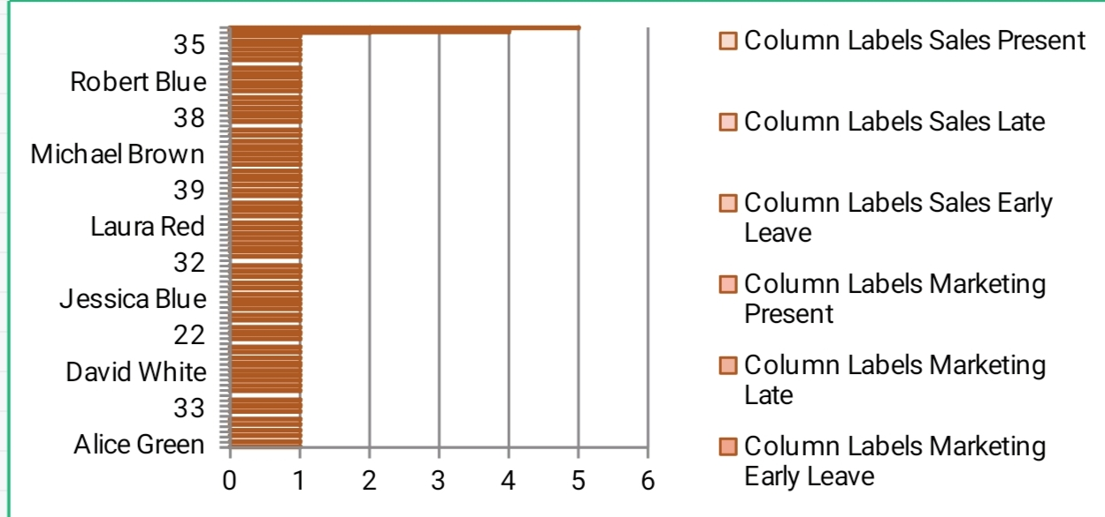
RESULTS
11

Slide 12
conclusion
Attendance Trends with Excel Charts
Visualizing employee attendance trends using Excel charts provides a powerful and accessible means of analyzing workforce behaviors and identifying key patterns. Through structured data representation and effective use of various chart types—such as line charts, bar charts, and heatmaps—organizations can gain clear insights into attendance patterns across different time periods and departments.
These visualizations enable HR managers and decision-makers to:
★ identify patterns
★ compare departments
★ correlate with performance
★ forecast trends

